Slide 1
LF Data Compression
Abrar Mohammed
LF Radio Lab, Georgia Tech
MS CS

Slide 2
Background
Need for Data Compression?
Resource cost to store
High Bandwidth and Time to transfer the data
Lossless vs Lossy compression
Experiment with cutting-edge compression techniques

Slide 3
Agenda
Data
Exploration
Matlab Datatypes
Statistics
Data Compression
One-shot vs Two-shot
Dictionary coding
Huffman coding
Zstandard
Performance
Zstd
Gzip vs Zstd
System Design
Folder structures
Scripts (TO DO)
Future works
Documentation
END

Slide 4
Data Exploration

Slide 5
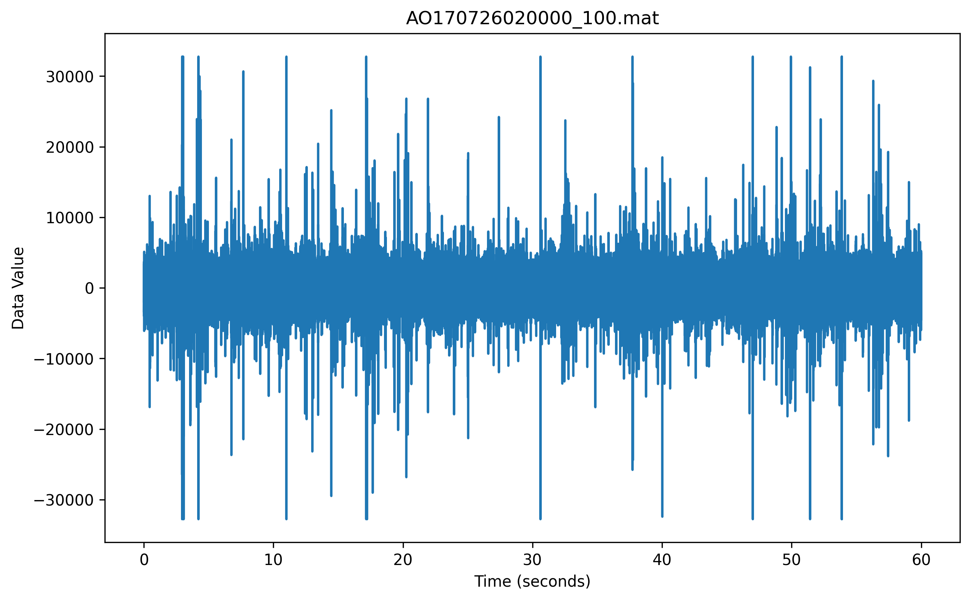
BROADBAND_2017– Arecibo
Statistics:
Unique values: 26054
Maximum: 32767
Minimum: -32768
fs =1MHz

Slide 6
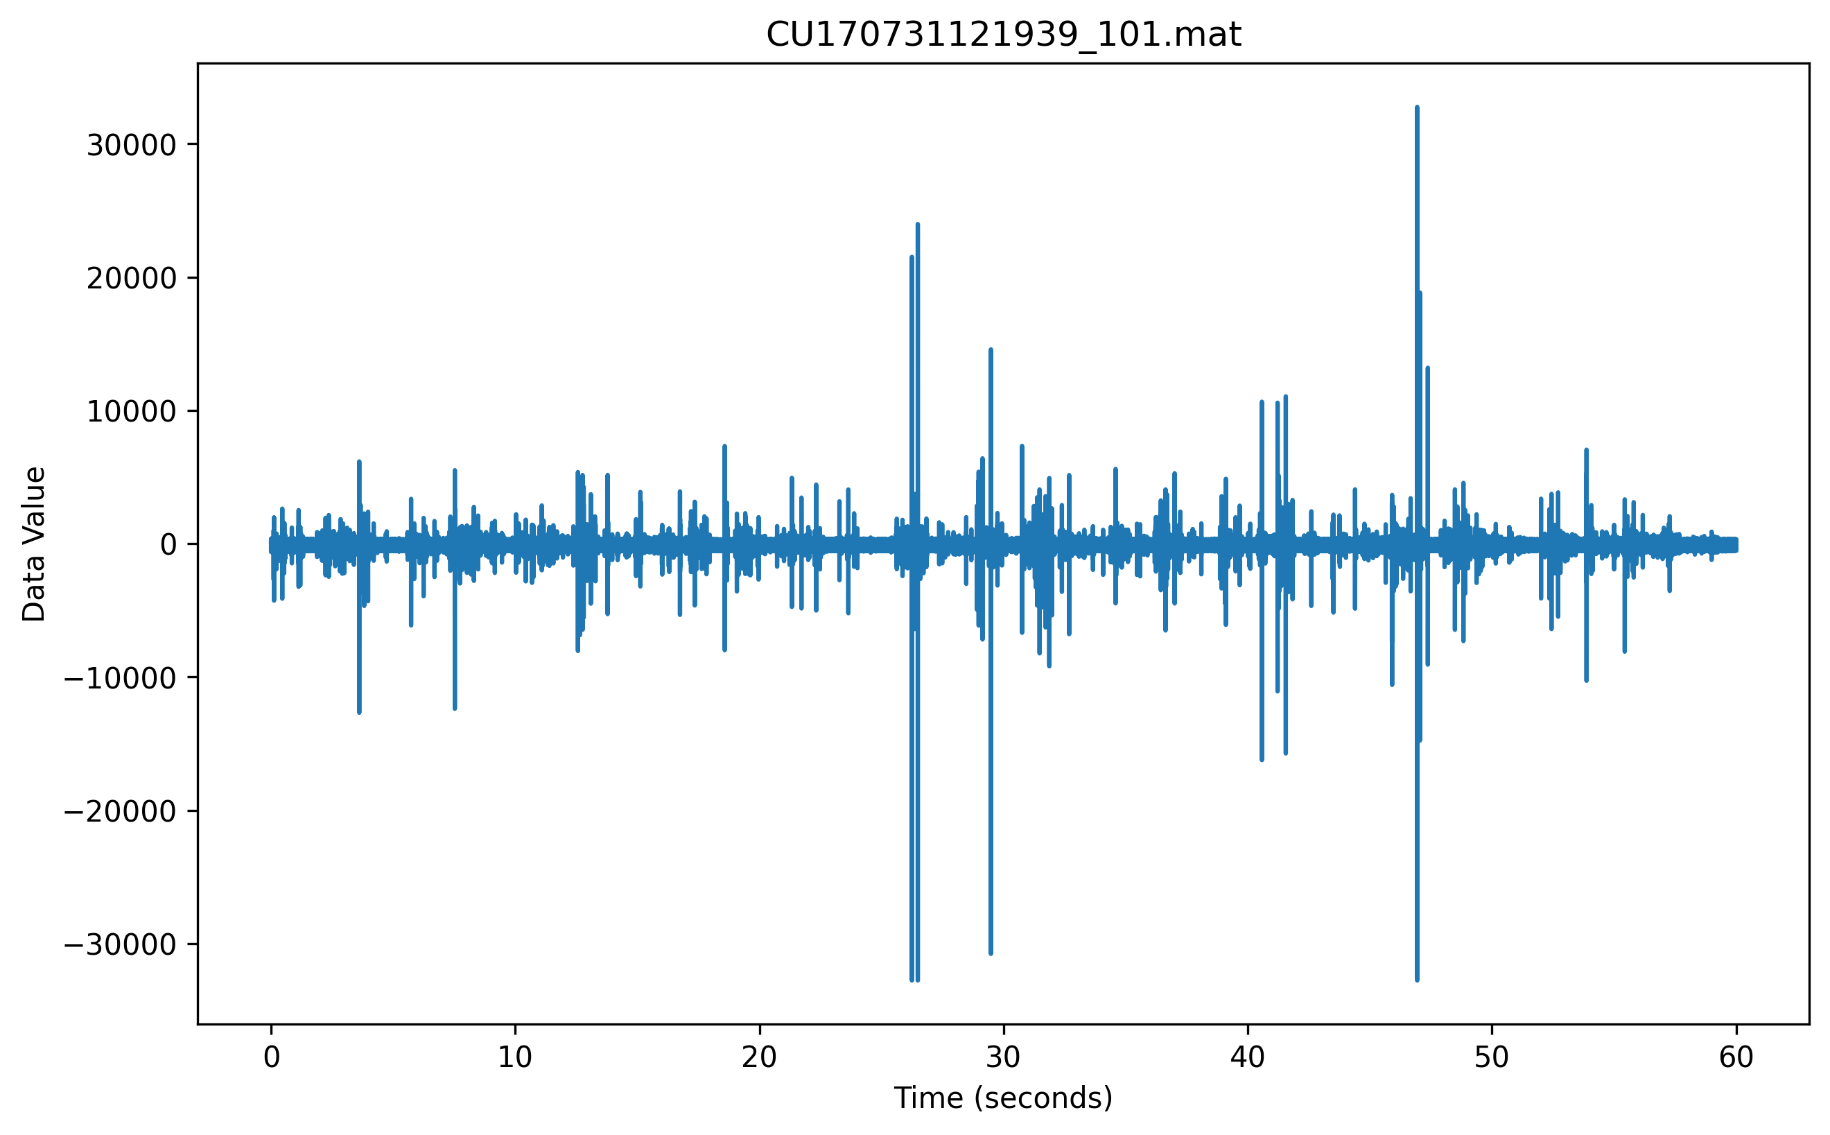
Broadband_2017 - Culebra
Statistics:
Unique values: 10282
Maximum: 32767
Minimum: -32768
fs = 1MHz

Slide 7
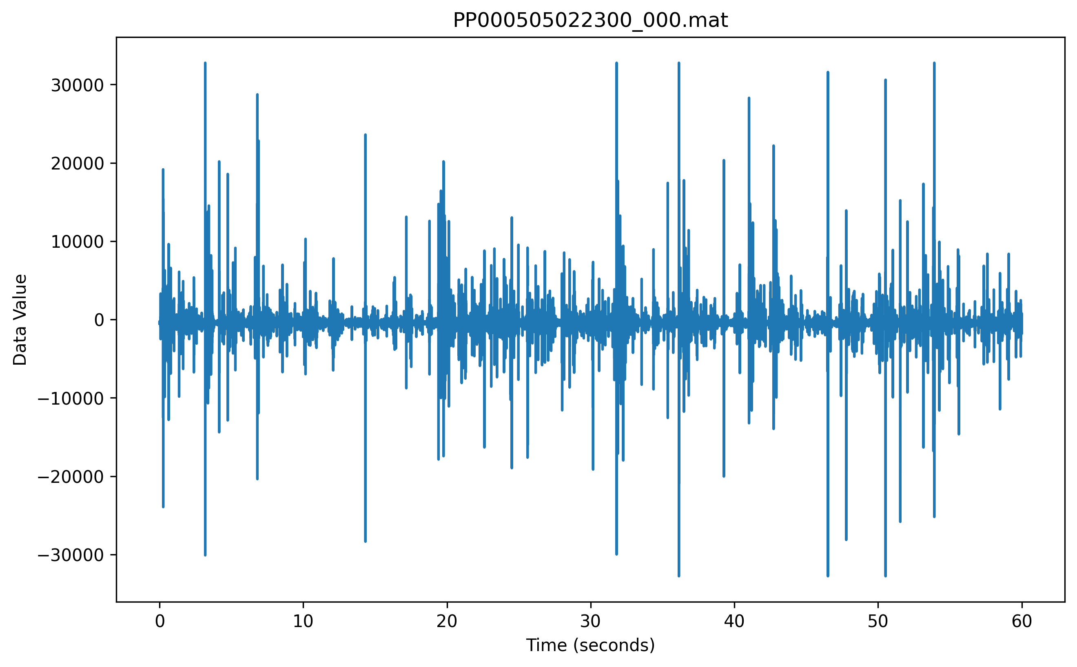
Broadband_2000 – Palmer Station
Statistics:
Unique: 7991
maximum: 32767
minimum: -32768
Unique: 7991
fs = 1MHz

Slide 8
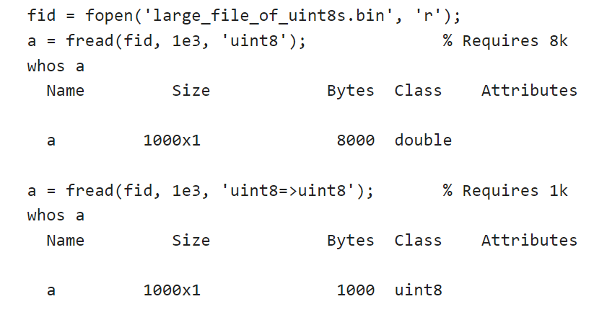
Datatypes
Broadband data is saved as “int16”; takes 2 Bytes of memory
‘matGetVariable.m’ script was developed to fetch the variables from .mat file
It uses fread() to read the variables
It is a common error to specify only the class of the data in the file, and not the class of the data MATLAB uses once it is in the workspace. As a result, the default double (8 Bytes) is used even if you are reading only 8-bit values.

Slide 9
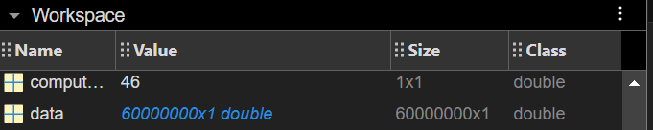
This takes space!
However,
save(‘filename’,’variables’,’version’) comes with inbuilt GZIP compression that saves memory

Slide 10
Data Compression/Encoding
Static codes: Fixed length of code word to a symbol
Dynamic Codes: More length is given to infrequent symbols and frequent occurring symbols take less length code word
Ex: applepie
Symbol | Static Coding | Dynamic Coding
a | 000 | 11
e | 001 | 1
i | 010 | 10
l | 011 | 01
p | 100 | 0
No. of bits 5*3=15bits 8bits

Slide 11
Two-shot vs One-Shot compression
Two-shot coding requires probability information of the symbols(characters/number etc) in the data stream, before hand
Ex: Static Huffman coding, Shannon-Fano coding
Using the P(X) the algorithm does the compression on the second scan of the data
Limitations: We need to know the data before hand + it’s computationally expensive to scan the data twice!
Data Stream: “applepie”
Symbols | a | e | i | l | p
P(X) | 1/8 | 2/8 | 1/8 | 1/8 | 3/8

Slide 12
On the other hand, One-shot coding builds the information on the move without the knowledge of data and requires only one scan Examples:
Dictionary Coding like LZ77, LZW, and 100 versions of LZ
Adaptive Huffman Coding
Lempel-Ziv-Welch(LZW) standard: Use a initial dictionary and build the dictionary as the new symbols arise in the data stream
Adaptive Huffman Coding: A greedy algorithm based binary tree construction of symbol coding that adjusts the nodes as the new data is seen. Runtime: O(log(n)) to add, search, modify.
Too lengthy to explain, so let’s move on
But remember “Dictionary” as a Initial information given or that is built as the data is explored

Slide 13
Zstandard: A new age compression method
Zstd published by Meta in 2012 is a lossless fast compression method
It uses Optimized Data structures based on combination of Huffman and Finite State Entropy compression
Advantages: Fine-tuning, Training mode to build dictionary, better compression ratios
Limitations: As any other lossless compression methods, performance is impacted by the entropy of the data

Slide 14
Performance
Comparison between Zstd and GZip (used by MATLAB)

Slide 15
2017 data
40%
MB
Notes:
About 16% better compression using Dictionary

Slide 16
2017 Data
GB

Slide 17
2000 Data
45%
MB
GB

Slide 18
System Design

Slide 19



Architecture
Dictionary
Compress
Script
.sh & .py
Folder
In-place compression
Folder
File1.mat
File1.mat.zst
FileN.mat
FileN.mat.zst

Slide 20
Architecture - Decompression
Dictionary
Decompress
Script
.sh & .py
Folder
In-place decompression
Folder
File1.mat.zst
File1.mat
FileN.mat.zst
FileN.mat

Slide 21
Documentation
Comprehensive step by step documentation of the process and running the scripts
Troubleshooting guide and best practices
Temporarily hosted as repository: https://github.com/AbrarAhmed647/LF_DataCompression_UsageDoc

Slide 22
Future Works
Integrating the access to compressed files hosted on webserver or Gdrive to a website for easy access and data sharing
Hosting the data on Cloud

Slide 23
Q/A

Slide 24
Thank you!

